Slide 1
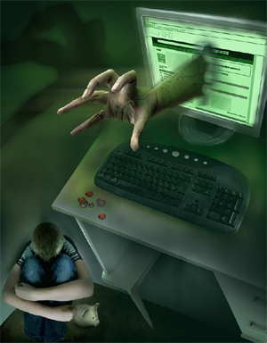
Cyber Bullying
prospects and prevention

Slide 2
What is it?
Cyber bullying is simply the use of any type of technology maliciously and intentionally to hurt someone else. Examples:
Harassing a person through text messages
Sending threatening or inappropriate emails
Posting hurtful messages on an individuals Facebook or twitter
Making fun of someone in chat rooms
Making and posting YouTube videos intended to hurt or harass someone

Slide 3
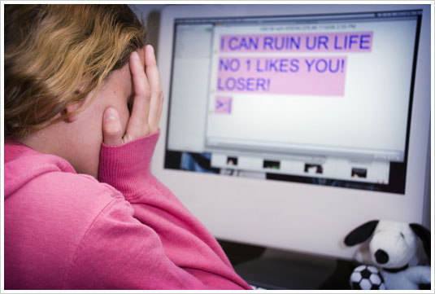
What is it? Cont.
Cyber bullying is typically aimed at younger adolescents and can lead to serious issues such as police involvement, school involvement, and teen suicide

Slide 4








Cyber Bullying Platforms
Some current popular social media:
Facebook
Instagram
Discord
Twitter
WordPress
WhatsApp
Telegram
Reddit

Slide 5




Cyber Bullying Mediums
John The Ripper
Nmap
Hydra
Nikto
Helps to crack the passwords of network services
Open-source software for password cracking
A network scanning tool
Scans web servers for dangerous files/CGIs

Slide 6
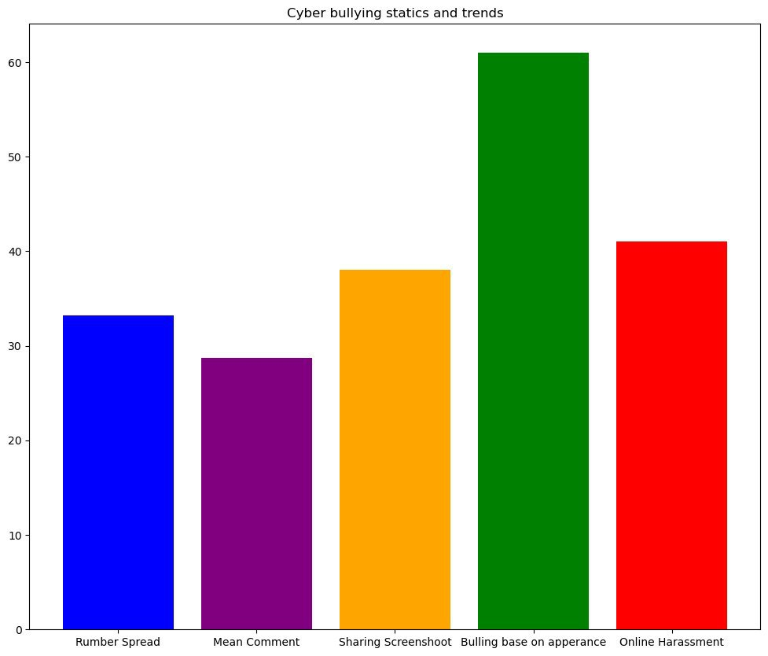
Here’s a concise presentation on Cyber Bullying Statistics and Trends:
Global Trends
Common Types of Online Bullying
Parental Perspectives

Slide 7


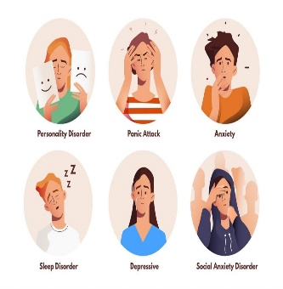
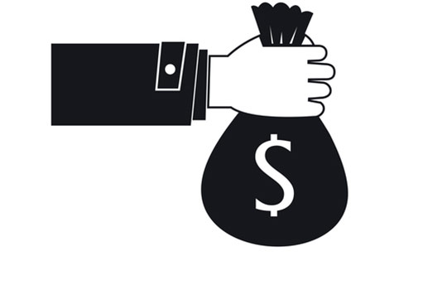


Negative Effects On Victims
Emotional Impact
Psychological Impact
Social Impact
Physical Impact
Financial Impact

Slide 8
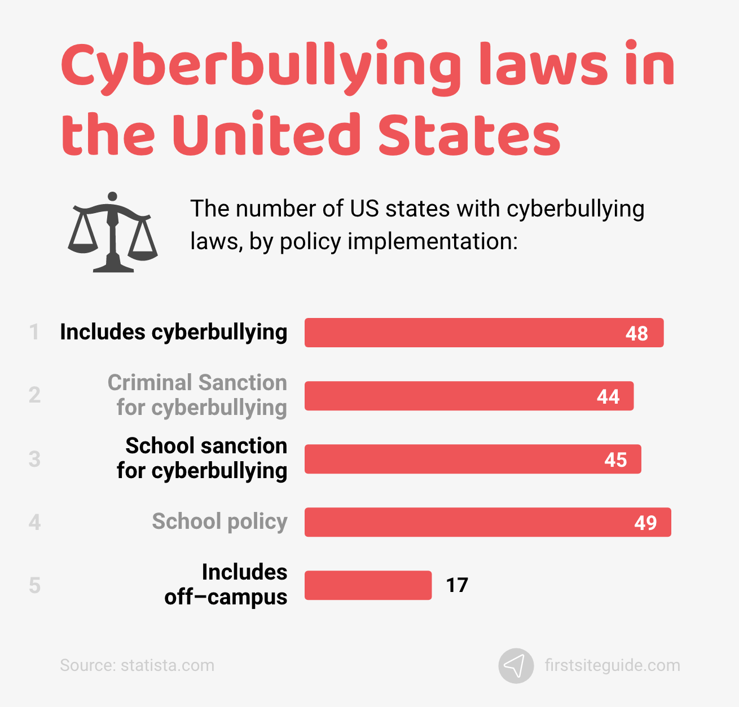
Global Perspectives on Cyberbullying

Slide 9


UNODC announced an international law.
Referred as an interpersonal cybercrime.
Punishment may vary depending on the severity
Three laws against it in Bangladesh
ICT Act 2016 and Digital security act 2018
Punishment can be up to imprisonment

Slide 10

Cyberbullying Prevention Strategies
Digital Citizenship Training
Education & Awareness
Encourage Positive Online Engagement
Promotion of Empathy
& Kindness
Safe Online Spaces
Empower Bystanders
Guardian Involvement
Collaboration With Technology Platforms

Slide 11

Thanks for keep attention.
Conclusion: Prevention & Awareness Once something is online, it is likely it’s out there forever. There is no delete button or eraser for the Internet.

